Slide 1

5 Learnings
Three days
of expert discussions
LVMR Media and Research Consultants
Leendert van Meerem
International Media Research Society, Cascais September 2016

Slide 2

The 2020 media landscape in five statements
Digital
Online
Mobile
OTT
The loss of “ratings based” advertising income in TV, Print, Radio

Slide 3
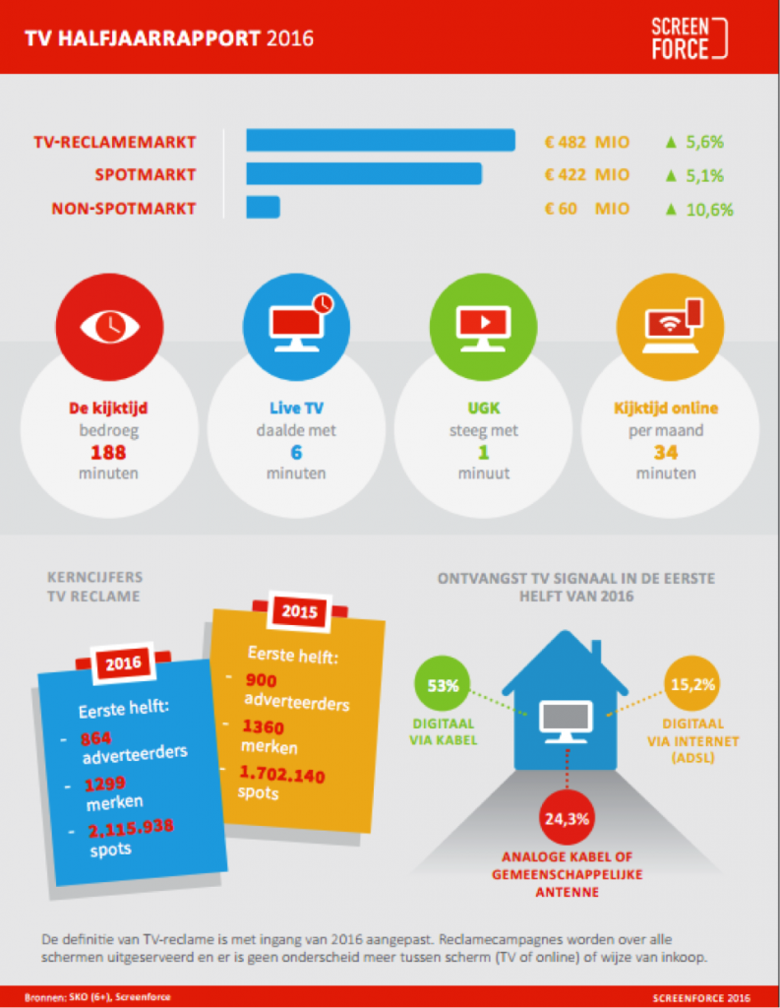
Online gain one minute per day
Three hours per day
Lost six minutes

Slide 4
Comments on previous slide
It is part of a public report from Screen Force, The Netherlands;
Referring the first 6 months of 2016 in comparison with first 6 months of 2015;
Online viewership of 34 minutes per month refers to the content of NPO, RTL and SBS, with a total market share of 70% .

Slide 5
Measurement issues
Measurement of digital is impossible without matching individual data with site centric “big “data.
Individual data are still needed, often still (2016) classical measurement takes care of the vast majority of the ratings volume.
Mobile is the big growing device type for all media consumption, but still small.
The big black box of fusing, matching, merging, calibrating.
The inescapable mismatch in definitions of contact, reach and frequency with the online contact definitions.

Slide 6
Four players: Media Owners, Media Agencies, Advertisers and the Research agencies
What about JIC’s?
When selling commercial communication was a license to print money, your competitors
are your joint friends, the “industry” is a comfortable trading club, your client is the lunch king
and the media agencies the oil in the machine!
When business is tough, anyone can be your enemy!
JIC’s in 2020
Less mutual trust
Less money available
Good total media research is expensive
Why should I help my competitor?
Joint Audience Measurement often means: Big players sponsoring small players

Slide 7
Four players: Media Owners, Media Agencies, Advertisers and the Research agencies
Advertisers
The value of classical media planning with classical survey/panel data is reduced to one of the many available sources of information.
Programmatic
The wet dream of programmatic is not yet over, but the value of it becomes questionable. Fewer experts believe the promised targeting; fraud and mismatch becomes visible. “50% is down the drain”.
Transparency is far away!

Slide 8
Four players: Media Owners, Media Agencies, Advertisers and the Research agencies
Media agencies
Media Agencies turned themselves into bad research companies and money makers with
programmatic buying. They pamper their big black box of research and model making and brand it as
their unique infallible instrument.
They claim transparency even when it is not there!
Research agencies
The big ones: The last ten years they have shuffled their internal organization in matrix, top down, bottom up, One, focus on big international clients, the world in weird regions, the business in weird business sections. The buzzwords in their strategy: online, digital, mobile. Avoid talking about response rates!
Fieldwork is outsourced, software is outsourced.
New start up’s in mobile, digital research are acquired. With lots of problems of integrating them.
The small ones: Grow fast in digital mobile and get acquired.

Slide 9
The 5th player?
Data Scientists
The new kings are the Data Scientists, formerly known as data analysts or even software programmers. They are the ones that are going to decide about the new definitions and the value of these self-programmed definitions of online contact. They will merge apples with mellons.

Slide 10



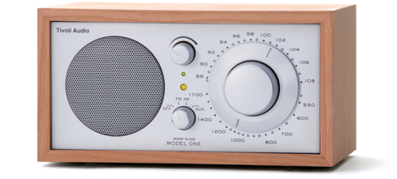
The future of what was called: the silo measurements
Online data are the central datasource
Viewing
Reading
Listening
Online

Slide 11

  The Big Game of definitions
  Merging data sources with different definitions
Sample data with big data
Big samples with small samples
Raw data with weighted data
Who is at the helm for taking decisions?
The power to the data scientist, merging experts and statisticians?
Notes:
11

Slide 12

Challenges
To bridge existing media data together with the new data sources. Shoe-horning.
1
Advertising contact reach need new definitions.
2
Deaf for bad data, any number will do.
3
Merging data has to be explained so it can be understood by non-experts.
4
Transparency is needed but further away than ever.
5

Slide 13

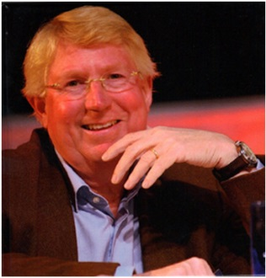
LVMR Media & Research Consultants
Leendert van Meerem
www.lvmr.nl
leendert@lvmr.nl

